Slide 1
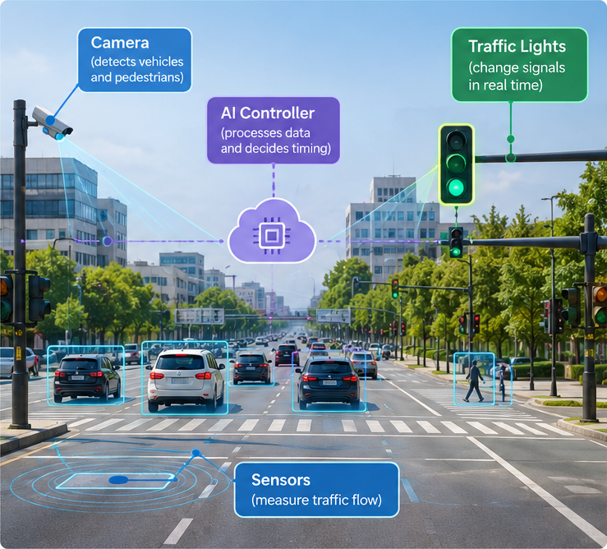




Smart Traffic Lights
How AI Reduces Traffic Jams
What are smart traffic lights?
Use real-time data
Sensors and cameras count vehicles and pedestrians.
Apply AI
The system decides the best timing for each direction.
Change the lights live
Not a fixed schedule: timing adapts in real time.
Smoother, safer traffic
Less waiting, fewer jams, better safety.
Notes:
SLIDE 1 – Introduction (about 1 minute)
Say: "Today we talk about smart traffic lights. A normal traffic light follows a fixed timer. A smart traffic light looks at the real traffic and adapts."
Key points:
1. It uses real-time data: cameras and sensors count cars and pedestrians.
2. AI (or an adaptive algorithm) analyzes the data and chooses the best timing.
3. The lights change dynamically, not only on a fixed schedule.
4. Result: less waiting, fewer traffic jams, safer roads.
Point at the picture: camera (detects), sensors (measure flow), AI controller (decides), traffic lights (act).

Slide 2




How It Works: Observe, Decide, Act
A smart intersection repeats this loop all day.
1. OBSERVE
2. DECIDE
3. ACT
Cameras & Sensors
AI Controller
Traffic Lights
They detect vehicles, pedestrians and traffic flow.
It analyzes the data and chooses the best signal timing.
Green, yellow and red times change in real time.
Then the loop starts again: the system keeps adjusting to the traffic.
Notes:
SLIDE 2 – How it works (about 1 minute)
Say: "A smart traffic light works in three steps: Observe, Decide, Act."
1. OBSERVE – Cameras and sensors detect cars, pedestrians and the traffic flow.
2. DECIDE – The AI controller receives this data and chooses the best timing for each direction.
3. ACT – The traffic lights change their green, yellow and red times in real time.
Then it repeats, all day long. This loop is the heart of the system.
Easy words: sensor = a device that measures something; controller = the "brain" that makes decisions.

Slide 3

Fixed Timer vs Smart Lights
Example: Road A has a long queue, Road B is almost empty.
Traditional light
Fixed schedule
Smart light
Adaptive, real-time
Same timing all day
Road B gets green even if empty
Road A cars keep waiting
Sensors see the long queue
Road A gets more green time
Road B gets less, safely
Long waiting time
Shorter waiting time
Smart lights react to what is happening now.
Notes:
SLIDE 3 – Fixed timer vs smart lights (about 1 minute)
Say: "Imagine two roads. Road A has a long queue. Road B is almost empty."
LEFT – Traditional light: it follows a fixed schedule. Road B still gets green time even if nobody is there, and the cars on Road A keep waiting.
RIGHT – Smart light: sensors see the long queue on Road A, so the system gives it more green time. Road B gets less green time, but safety rules are still respected (for example, pedestrians always have time to cross).
Conclusion: the smart light reacts to what is happening now, so waiting time goes down.
Note: not every smart system uses AI – some use simple rules or optimization algorithms. The important idea is "adaptive".

Slide 4


Benefits and Challenges
Smart traffic lights help a lot, but they must be designed carefully.
Benefits
Challenges
Less waiting time
Fewer traffic jams
Better safety for everyone
Faster way for ambulances
Sensors can fail (rain, night)
High cost and maintenance
Privacy: cameras collect data
Must always stay safe
The goal is not only faster cars, but safer movement for everyone.
Notes:
SLIDE 4 – Benefits and challenges (about 1 minute)
BENEFITS (left): less waiting time, fewer traffic jams, better safety, and in some systems a faster way through intersections for ambulances and fire trucks.
CHALLENGES (right):
- Sensors can fail or be less accurate in rain or darkness.
- Installation and maintenance cost money.
- Privacy: cameras collect data, so it must be protected and limited to what is needed.
- Safety first: the system must never create dangerous or confusing signals.
Conclusion: the goal is not just faster cars, it is safer and more efficient movement for everyone (cars, pedestrians, cyclists, buses).

Slide 5

A Cyber-Physical System
Computing systems monitor and control the physical world.
Physical world
Roads, cars, pedestrians
Digital system
Sensors, data, AI
Physical action
Traffic lights change
What comes next?
Real-world data
+ Smart algorithms
= Smarter cities
Connected cars talk to the traffic lights
AI predicts traffic before jams happen
Smoother traffic, cleaner cities
Thank you! Questions?
Notes:
SLIDE 5 – Cyber-physical system, future, conclusion (about 1 minute)
Say: "Smart traffic lights are a perfect example of a cyber-physical system, or CPS."
A CPS = computing systems that monitor and control a physical environment.
- Physical world: roads, cars and pedestrians.
- Digital system: sensors collect data, AI analyzes it.
- Physical action: the traffic lights change.
Then the loop starts again.
Future: connected cars will share information with the traffic lights, and AI will predict traffic before jams appear.
Final message: real-world data + smart algorithms = smarter cities.
Then say "Thank you, any questions?"
Possible questions and short answers:
- Do all smart lights use AI? No, some use simple rules or optimization.
- Is it safe? Yes, if designed with minimum green times and safety rules.
- What about privacy? Data should be protected and limited to what is necessary.

